Slide 1



SUPERSTORE FINAL
View in Power BI
Last data refresh:
3/25/2024 5:23:54 PM UTC
Downloaded at:
3/25/2024 5:32:26 PM UTC

Slide 2
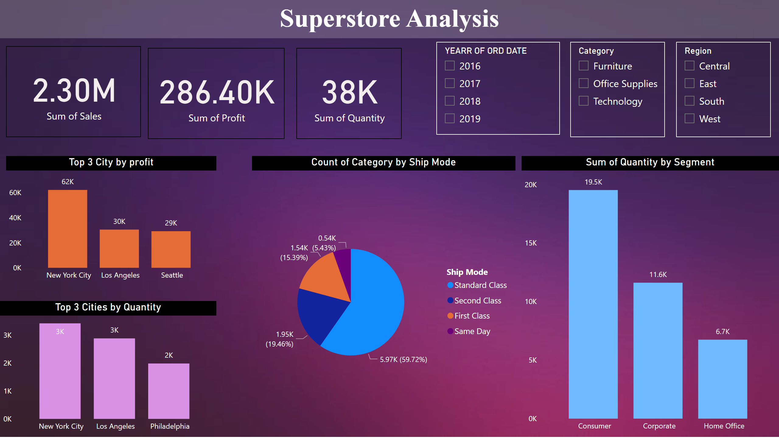
Statewise
Notes:
textbox
No alt text provided
card
No alt text provided
card
No alt text provided
card
No alt text provided
slicer
No alt text provided
Top 3 City by profit
No alt text provided
slicer
No alt text provided
Top 3 Cities by Quantity
No alt text provided
clusteredColumnChart
No alt text provided
slicer
No alt text provided
pieChart
No alt text provided

Slide 3
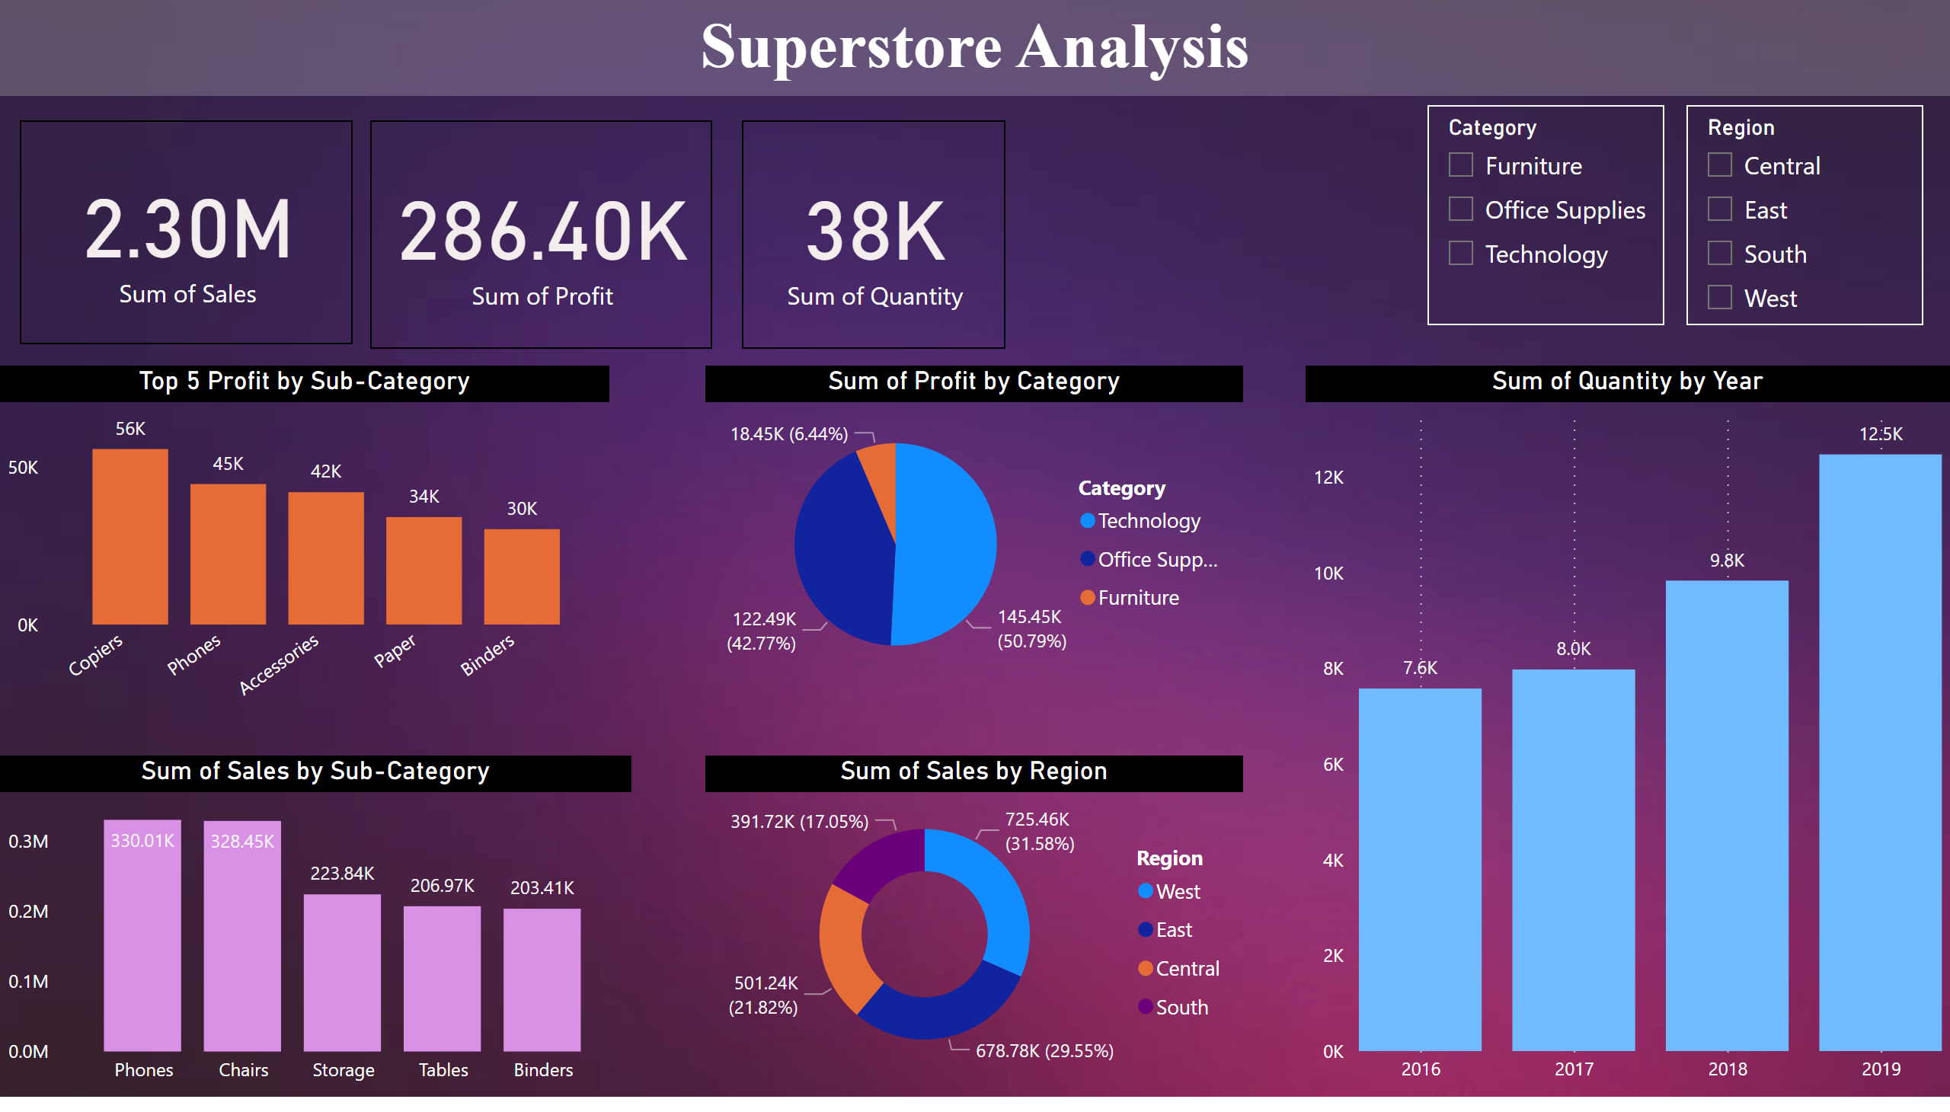
Revenue
Notes:
textbox
No alt text provided
slicer
No alt text provided
card
No alt text provided
card
No alt text provided
card
No alt text provided
slicer
No alt text provided
Top 5 Profit by Sub-Category
No alt text provided
clusteredColumnChart
No alt text provided
pieChart
No alt text provided
columnChart
No alt text provided
donutChart
No alt text provided

